Slide 1
CROSS-BORDER TRADE ENVIRONMENT
Dr. Kwangsoo Kim
Konkuk University

Slide 2
AGENDA
International Trade Theory
Trade Policy
World Trading System
Implications for Businesses

Slide 3
COMPONENTS OF GLOBAL BUSINESS ENVIRONMENT
World/General
Country/General
Trade
FDI
Economic
Market/Industry
Demographic
Competitors
Technologies
Customers
Suppliers
Social
Firm
Legal
Creditors
Labor union
Distributors
Stock holders
Regional
Foreign
Exchange
Political
Technological
International
Institutions

Slide 4
International Trade Theory

Slide 5
INTERNATIONAL TRADE THEORY
Mercantilism
Absolute Advantage
Comparative Advantage
Heckscher-Ohlin Theory
Product Life Cycle Theory
Strategic Trade Theory
Competitive Advantage (Porter’s Diamond)

Slide 6
Mercantilism
Mid-16th up to 18th centuries
A nation’s power and wealth depend on accumulated treasure (precious metals).
Gold and silver are the currency of trade.
Nations should have a trade surplus by
- Maximizing exports through subsidies.
- Minimizing imports through tariffs and quotas.
Trade is a zero-sum game.
A nation can gain in trade only at the expense of other nations.
Government intervention is good.

Slide 7
Theory of Absolute Advantage
Adam Smith: Wealth of Nations (1776)
Assumes: 1) two nations, 2) one factor of production – labor, 3) two commodities
A nation has absolute advantage in a commodity when the nation produces it more efficiently than the other nation.
Two nations trade only when each has absolute advantage in one commodity and absolute disadvantage in the other commodity.
Both nations gain by each specializing in producing the commodity with its absolute advantage and exchanging part of its output with the other nation for the commodity with its absolute disadvantage.
All nations will gain from free trade (Trade is a positive sum game).
Laissez-faire (no/little government intervention)
Sources of Advantage: Higher productivity - Nature like climate

Slide 8
Theory of Absolute Advantage
G
200 units of resources in Ghana and Korea, respectively
5 10 15 20
Cocoa
A
K
B
G’
K’
0 5 10 15 20
Rice

Slide 9
Absolute Advantage and Gains from Trade
Resources Required to Produce 1 Ton of Cocoa and Rice
Cocoa Rice
Ghana 10 20
S. Korea 40 10
Production and Consumption without Trade
Ghana 10.0 5.0
S. Korea 2.5 10.0
Total production 12.5 15.0
Production with Specialization
Ghana 20 0
S. Korea 0 20
Total production 20 20
Consumption after Ghana Trades 6T of Cocoa for 6TSouth Korean Rice
Ghana 14.0 6.0
S. Korea 6.0 14.0
Increase in Consumption as a Result of Specialization and Trade
Ghana 4.0 1.0
S. Korea 3.5 4.0

Slide 10
Theory of Comparative Advantage
David Ricardo: Principles of Political Economy (1817).
Assumes:
1) Two nations and two commodities only
2) Perfect mobility of labor within each nation, but immobility between nations
3) Constant cost of production; 4) No transportation costs; 5) No technical change, etc
Even if a nation has absolute disadvantage in producing both commodities, both nations can still gain from trade.
A nation should specialize in producing and exporting the commodity with comparative advantage (larger absolute advantage or smaller absolute disadvantage) and import the commodity with comparative disadvantage (smaller absolute advantage or larger absolute disadvantage).
All nations gain from free trade (Trade is a positive sum game).
Sources of Advantage: Higher productivity - labor

Slide 11
Theory of Comparative Advantage
G
C
200 units of resources in Ghana and Korea, respectively
5 10 15 20
Cocoa
A
K
B
2.5
K’
G’
0 5 10 15 20
3.75
7.5
Rice

Slide 12
Comparative Advantage and Gains from Trade
Resources Required to Produce 1 Ton of Cocoa and Rice
Cocoa Rice
Ghana 10 13.33
S. Korea 40 20
Production and Consumption without Trade
Ghana 10.0 7.5
S. Korea 2.5 5.0
Total production 12.5 12.5
Production with Specialization
Ghana 15 3.75
S. Korea 0.0 10.0
Total production 15 13.75
Consumption after Ghana Trades 4T of Cocoa for 4TSouth Korean
Ghana 11 7.75
S. Korea 4 6
Increase in Consumption as a Result of Specialization and Trade
Ghana 1.0 0.25
S. Korea 1.5 1.0

Slide 13
Heckscher-Olin Theory: Comparative advantage based on factor endowments
Assumes
- Two nations (1 & 2), two commodities (X & Y), and two factors of
production (labor & capital)
- Commodity X (labor intensive) & Y (capital intensive) in both countries
- Same technology in production used in both countries
- Constant returns to scale
- Incomplete specialization
- Equal tastes in both nations
- Perfect competition in both commodities & factor markets in both nations
- Perfect internal factor mobility but no international factor mobility
- No transportation costs, tariffs, other barriers
- Full employment of all resources in both nations
© McGraw Hill Companies, Inc.,2000
4-18

Slide 14
Heckscher-Olin Theory: Comparative advantage based on factor endowments
A nation will export the commodity whose production requires the intensive use of the nation’s relatively abundant and cheap factor and import the commodity whose production requires the intensive use of the nation’s relatively scarce and expensive factor.
The relatively labor-rich nation should export the relatively labor-intensive commodity and imports the relatively capital-intensive commodity.
The differences in relative factor abundance (factor endowments) among nations is the basic determinants of comparative advantage.
Source of advantage – factor endowments

Slide 15
Product Life Cycle Theory
Raymond Vernon (1966)
As products mature, the location of optimal production and sales can change.
This affects the direction and flow of exports and imports.
Globalization and integration of the economy makes this theory less valid.

Slide 16
Product Life Cycle Theory
Quant
i
ty
High Income Countries
production
Exports
Imports
consumption
1
2
3
4
5
6
7
8
9
10
11
12
13
14
15
Exports
Medium Income Countries
Imports
1
2
3
4
5
6
7
8
9
10
11
12
13
14
15
Low Income Countries
Exports
Imports
Time
1
2
3
4
5
6
7
8
9
10
11
12
13
14
15
New Product
Maturing Product
Standardized Product
Stages of Production Development

Slide 17
Strategic Trade Theory
Krugman in the 1970s.
Firms that establish a first-mover advantage in the production of a new product may later dominate global trade in that product.
This kind of industries has substantial economies of scale with high fixed costs.
World demand will support few competitors. Hence, first mover advantages are great. “Getting there first” is critical.
This promotes government intervention and strategic trade policy.
Example: Boeing & Airbus

Slide 18
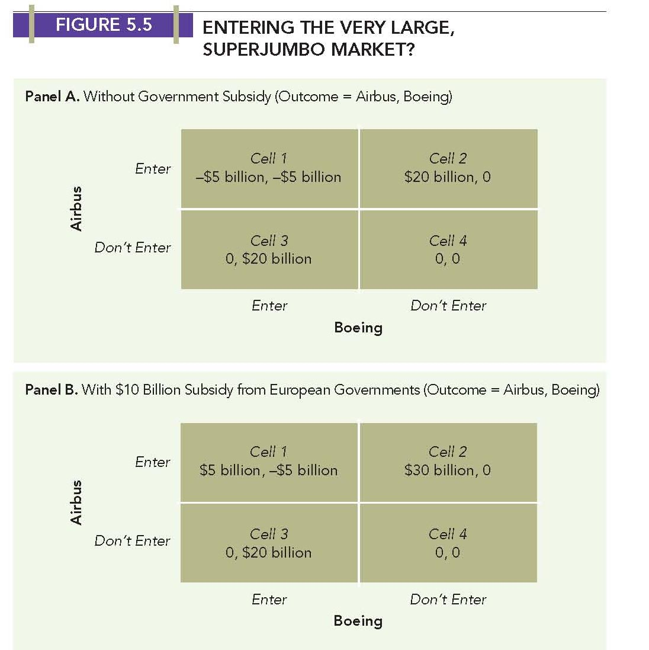
Strategic Trade Theory

Slide 19
Theory of Competitive Advantage (Porter’s Diamond)
Porter: The Competitive Advantage of Nations (1990)
Addresses the question of why a nation achieves international
competitiveness in a particular industry.
Argues that an industry of a nation with the following four
conditions met tends to have international competitive advantage:
- Factor conditions
- Market conditions
- Related and supporting industries
- Company strategy, structure, and rivalry
Sources of Advantage:
Competitive Advantage = Man-made comparative advantage

Slide 20
Theory of Competitive Advantage (Porter’s Diamond)
Chance
Company Strategy,
Structure,
and Rivalry
Factor
Conditions
Demand
Conditions
Related
and Supporting
Industries
Government

Slide 21
Trade Policy

Slide 22
INSTRUMENTS OF TRADE POLICY
Instruments for restricting international trade
(Instruments for protection)
Tariffs
Import Quotas
Voluntary Export Restraints
Subsidies
Domestic Content Requirements
Antidumping Policies
Administrative Policies, etc.

Slide 23
INSTRUMENTS OF TRADE POLICY
Tariffs – oldest form of trade policy
- Specific: US$10 per unit imported
- Ad valorem: percentage per unit imported
Import Quotas:
- Restriction on the quantity of goods imported into a country.
Voluntary Export Restraints:
- Quota on trade imposed by exporting country, typically at the request of the importing country.
- Effects are the same as those of tariffs; tighter restriction.

Slide 24
INSTRUMENTS OF TRADE POLICY
Subsidies
- Payment to domestic producers: cash grants, tax breaks, low-interest loans, gov’t equity participation(Airbus), etc.
Domestic(Local) Content Requirements
- Requires some specific percentage of goods to be produced domestically to be able to sell them in the local market
Antidumping Policies
- Selling goods in a foreign market below production costs or fair market value -> seek imposition of tariffs (countervailing duties)
Administrative Policies
- Bureaucratic rules to make it difficult for imports to enter a country (e.g., Tulip bulbs, Federal Express)

Slide 25
IMPACT OF TRADE POLICY
Impact of a government’s restricting international trade (Impact of protection)
Good for domestic producers
Good for the government
Bad for domestic consumers

Slide 26
IMPACT OF TRADE POLICY
P
S_{dom}
Consumer
surplus
P’
Nation 1
Commodity X
Producer
surplus
D_{dom}
O
Q’
Q

Slide 27
IMPACT OF TRADE POLICY
P
S_{dom}
P’
P_{W}
S _{world}
D_{dom}
O
Q₁
Q’
Q₂
Q

Slide 28


IMPACT OF TRADE POLICY
P
Area edbc equals loss
of consumer surplus
S_{dom}
a
P_{W} + t
e
d
S _{world} _{+ tariff}
Tariff
c
b
P_{W}
S _{world}
D_{dom}
O
Q₁
Q₃
Q₄
Q₂
Q

Slide 29

IMPACT OF TRADE POLICY
P
Impact of a government’s restricting international trade (protection)
Good for domestic producers
Good for the government
Bad for domestic consumers
S_{dom}
a
Area 1 equals gain in
producer surplus
Area 3 equals gain
in tariff revenue
P_{W} + t
e
d
S _{world} _{+ tariff}
Tariff
c
1
2
3
4
b
P_{W}
S _{world}
D_{dom}
O
Q₁
Q₃
Q₄
Q₂
Q

Slide 30
IMPACT OF TRADE POLICY
P
Impact of a government’s restricting international trade (protection)
Good for domestic producers
Good for the government
Bad for domestic consumers
S_{dom}
a
Areas 2 + 4
equals
net loss
P_{W} + t
e
d
S _{world} _{+ tariff}
Tariff
c
1
2
3
4
b
P_{W}
S _{world}
D_{dom}
O
Q₁
Q₃
Q₄
Q₂
Q

Slide 31
POLITICAL ARGUMENTS FOR PROTECTION
Protecting domestic jobs and industries.
National security.
- Defense industries - semiconductors.
Retaliation.
Protecting consumers.
Furthering foreign policy objectives.
Protecting human rights.
- MFN (most favored nation)

Slide 32
ECONOMIC ARGUMENTS FOR PROTECTION
Infant industry.
- Oldest argument - Alexander Hamilton, 1792.
- Protected under the WTO.
- Only good if it makes the industry efficient.
Strategic trade policy.
- Government helps raise national income if the first-mover advantage is achieved.
- Government intervention may help domestic firms overcome the first-mover advantage of foreign firms.

Slide 33
World Trading System

Slide 34
WORLD TRADING SYSTEM
Prior to 1947
From Smith to the Great Depression (England to US)
1947-1979
GATT, trade liberalization, & economic growth
1980-1994
Rise of Japan, US trade deficit, Ineffective GATT
1995-
World Trade Organization; Uruguay Round (1986-1994)

Slide 35
General Agreement on Tariffs and Trade (GATT)
An international organization in a trade arena similar to UN in a political arena
GATT proposed by US in 1947 – 19 members
Multilateral agreements to liberalize trade by eliminating tariffs, subsidies, import quotas, etc.
Covers trade in manufacturing goods/commodities only
Used ‘rounds’ to gradually reduce trade barriers.

Slide 36
GATT Negotiating Rounds
Growth Under GATT
Geneva 1947 19
Annecy 1949 13
Torquay 1950-51 38
Geneva 1956 26
Dillon 1960-62 45
Kennedy 1964-67 62
Tokyo 1973-79 99
Uruguay 1986-94 117
Doha 2001- 157
9.0 8.5 8.0 7.5 7.0 6.5 6.0 5.5 5.0 4.5 4.0
%
1953-63
1963-73
World Trade
World Income

Slide 37
Average Reduction in US Tariff Rates

Slide 38
Uruguay Round
Produced the most comprehensive trade agreement in history.
Created the World Trade Organization (WTO) in January 1995.
Impacted:
- Applied GATT rules to cover trade in services in addition to trade in goods & commodities
- Sought to write rules governing the protection of intellectual property (patents, copyrights, and trademarks)
- Sought to reduce agriculture subsidies (US/EU).
Strengthened the GATT’s monitoring and enforcement mechanisms

Slide 39
World Trade Organization
Became an umbrella organization that encompasses:
- GATT
- General Agreement on Trade in Services (GATS)
- Agreement on Trade-Related Aspects of IP Rights(TRIPS), etc
WTO’s Main Function:
- Implementation, administration and operation of the covered agreements
- Forum for negotiations / new agreements(Telecommunications / financial services agreements in 1997)
- Dispute settlement (104 disputes brought to WTO in the first 3 years, while 196 handled by GATT during its 50-year history).
- Review of national trade policies

Slide 40
WTO in Seattle (Millennium Round)
To further reduce barriers to trade and investment:
- Reducing antidumping actions
- Reducing protectionism in agriculture
- Protecting intellectual property
- Greater market access for industrial goods and services
But failed primarily because of the issues of:
- Eliminating subsidies to agricultural exporters (US vs. EU)
- Writing “basic labor rights” into the law of the world trading system (US vs. Developing countries)
- Environmental concerns, human rights, and labor-related issues (Developed vs. Developing countries)

Slide 41
Doha Round
The agreed agenda for the talk includes:
- Cutting tariffs on industrial goods and services
- Phasing out subsidies to agricultural producers
- Reducing barriers to cross-border investment
- Limiting the use of antidumping laws
To be successful, members have to give in something.
- EU & Japan – subsidy to farmers
- US – antidumping practices – steel producers for example
- Developing countries – opening up their market, etc.

Slide 42
World Trade Organization as of 2022
WTO: 164 members, including China(2001) and Russia(2012)
WTO: Experience to date
- WTO as global police
- Expanded trade agreements: goods + services & investment
WTO Unresolved issues
- Antidumping actions
- Protectionism in agriculture
- Protection of intellectual property
- Market access for nonagricultural goods and services
WTO does not function properly.
Emergence of bilateral and regional trade agreements
The world trading system is under threat.

Slide 43
Implications for Businesses

Slide 44
IMPLICATIONS FOR BUSINESSES
Firms operate globally within the context of trade environment, and they have room for influencing and maneuvering the context:
Location implications:
Firms need to exploit location advantages. Different countries have advantages in different productive activities, and it makes sense to disperse business activities to countries where they can be performed most efficiently.
First-mover implications:
Firms that establish a first-mover advantage in the production of a new product may later dominate global trade in that product. It pays to invest substantial financial resources in building a first-mover or early-mover advantage.

Slide 45
IMPLICATIONS FOR BUSINESSES
Policy implications:
Firms can exert a strong influence on government policy toward trade. Firms may lobby for free trade or for protection.
Trade barriers impact firm strategy:
Trade barriers can be both threats and opportunities for firms
- raising the cost of doing business and pushing firms to
disperse their productive activities globally.
These are likely to eventually facilitate globalization.

